Slide 1
Monitoring particle and exosome count of cancer patient plasma pre-treatment

Slide 2
Experimental Details for plasma lung cancer stage one plasma
Used samples: all stage one
Plasma volume: 20 µl.
Type of Cancer: unknown.
Concentration: unknown.
Size Distribution: unknown.
Experimental duration: 60 min.
Antibody used: CD9, CD81, and CD63.

Slide 3
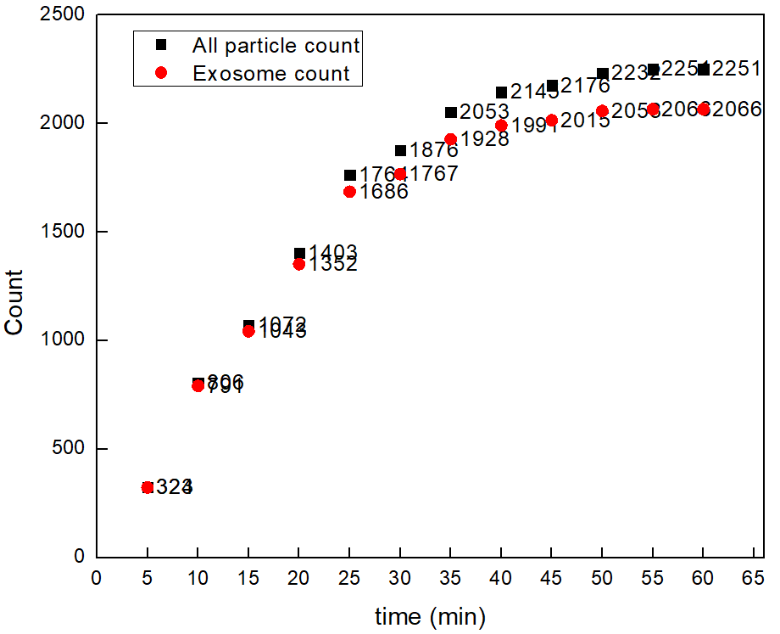

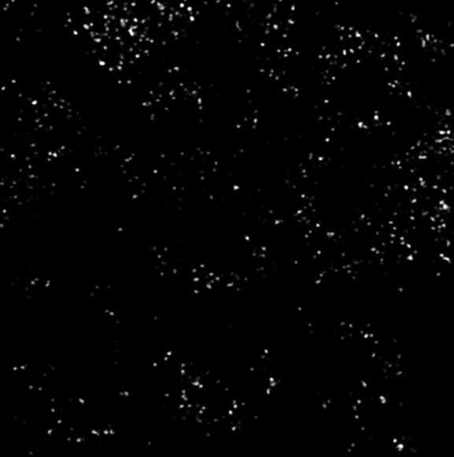
PANORAMA of Plasma Sample 0737-2A
Time: 60 min
Count: 2251 (185)
Time: 60 min wash
Count: 1048
Note: Before wash count exceeds the CI of stage 3 (500-1200)
After wash count exceeds the CI for stage 3 (155-304)
Note: 31 % response to miRNA-21
Scale bar: 10 µm

Slide 4
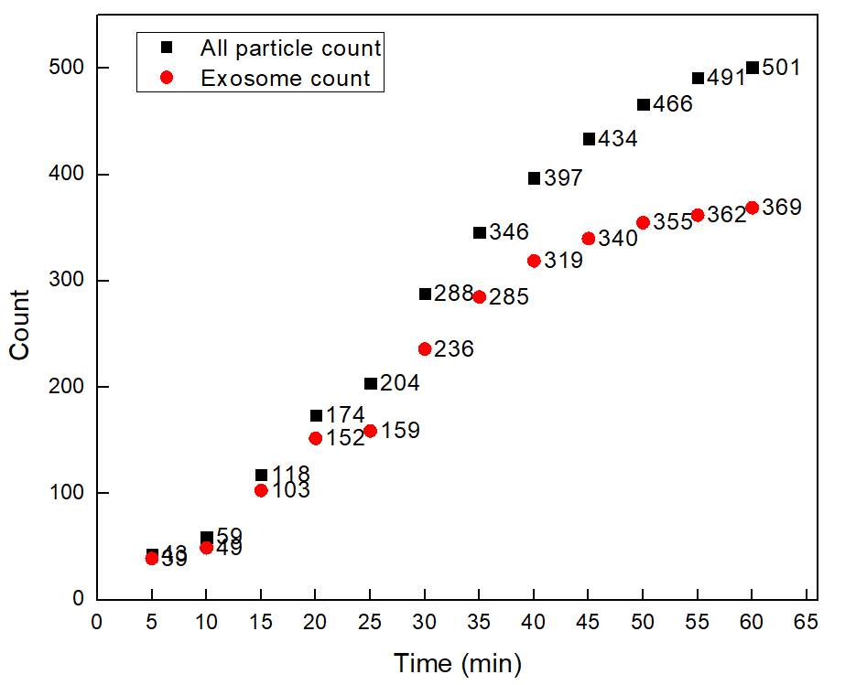


PANORAMA of Plasma Sample 0737-13A
Time: 60 min
Count: 501 (132)
Time: 60 min wash
Count: 129
Note: Before wash count matches the CI of stage 3 (500-1200)
After wash count slightly lower CI for stage 3 (155-304)
Note: 0 % response to miRNA-21
Scale bar: 10 µm

Slide 5
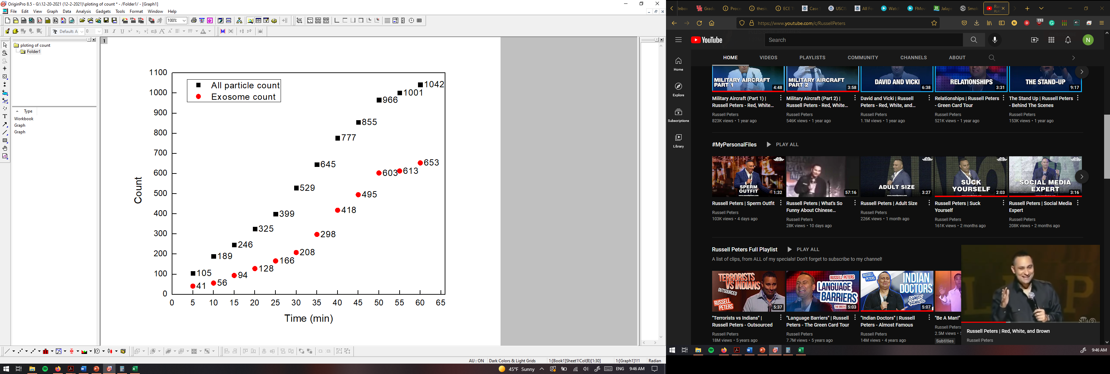
PANORAMA of Plasma Sample 0737-17A
Time: 60 min
Count: 1042 (329)
Time: 60 min wash
Count: 104
Note: Before wash count matches the CI of stage 3 (500-1200)
After wash count slightly lower CI for stage 3 (155-304)
Note: 0 % response to miRNA-21
Scale bar: 10 µm

Slide 6
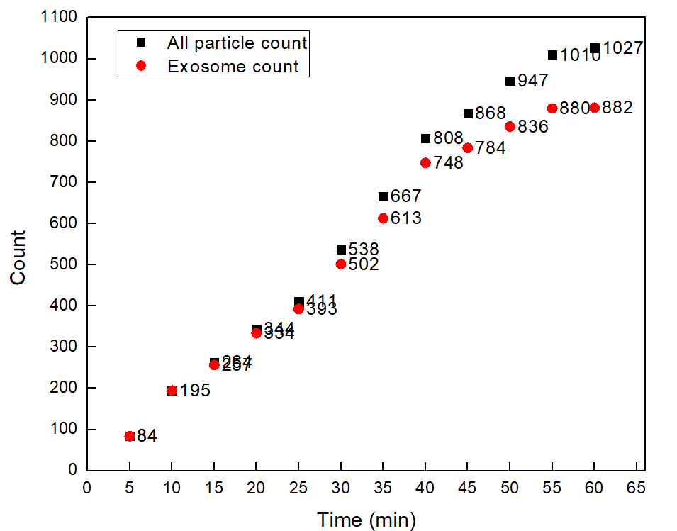
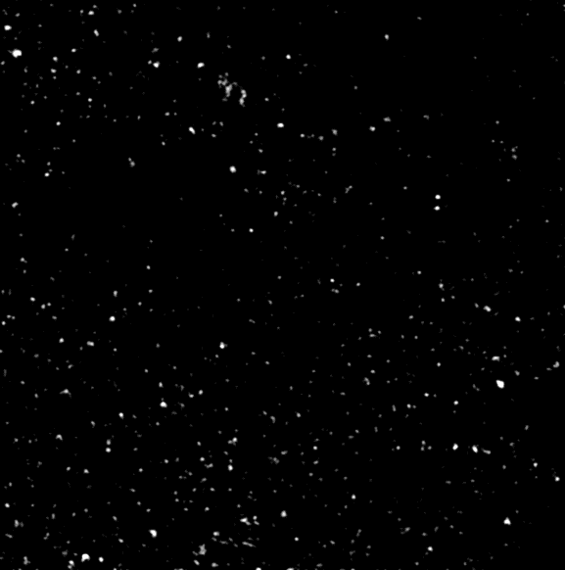

PANORAMA of Plasma Sample 0737-19A
Time: 60 min
Count: 1027 (145)
Time: 60 min wash
Count: 362
Note: Before wash count matches the CI of stage 3 (500-1200)
After wash count slightly lower CI for stage 3 (155-304)
Note: 2.4 % response to miRNA-21
Scale bar: 10 µm

Slide 7
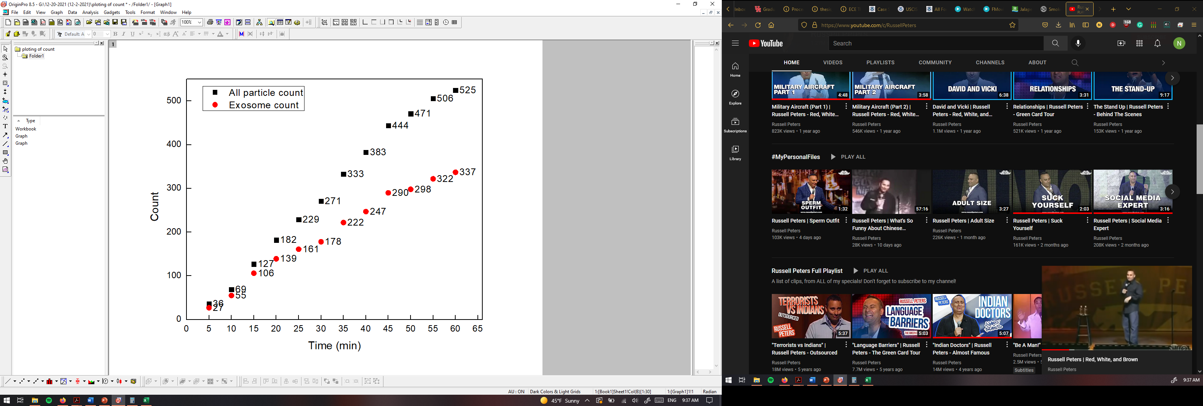
PANORAMA of Plasma Sample 0737-24A
Time: 60 min
Count: 525 (188 large)
Time: 60 min wash
Count: 109
Note: Before wash count matches the CI of stage 3 (500-1200)
After wash count matches the CI for stage 3 (155-304)
Note: 0 % response to miRNA-21
Scale bar: 10 µm

Slide 8
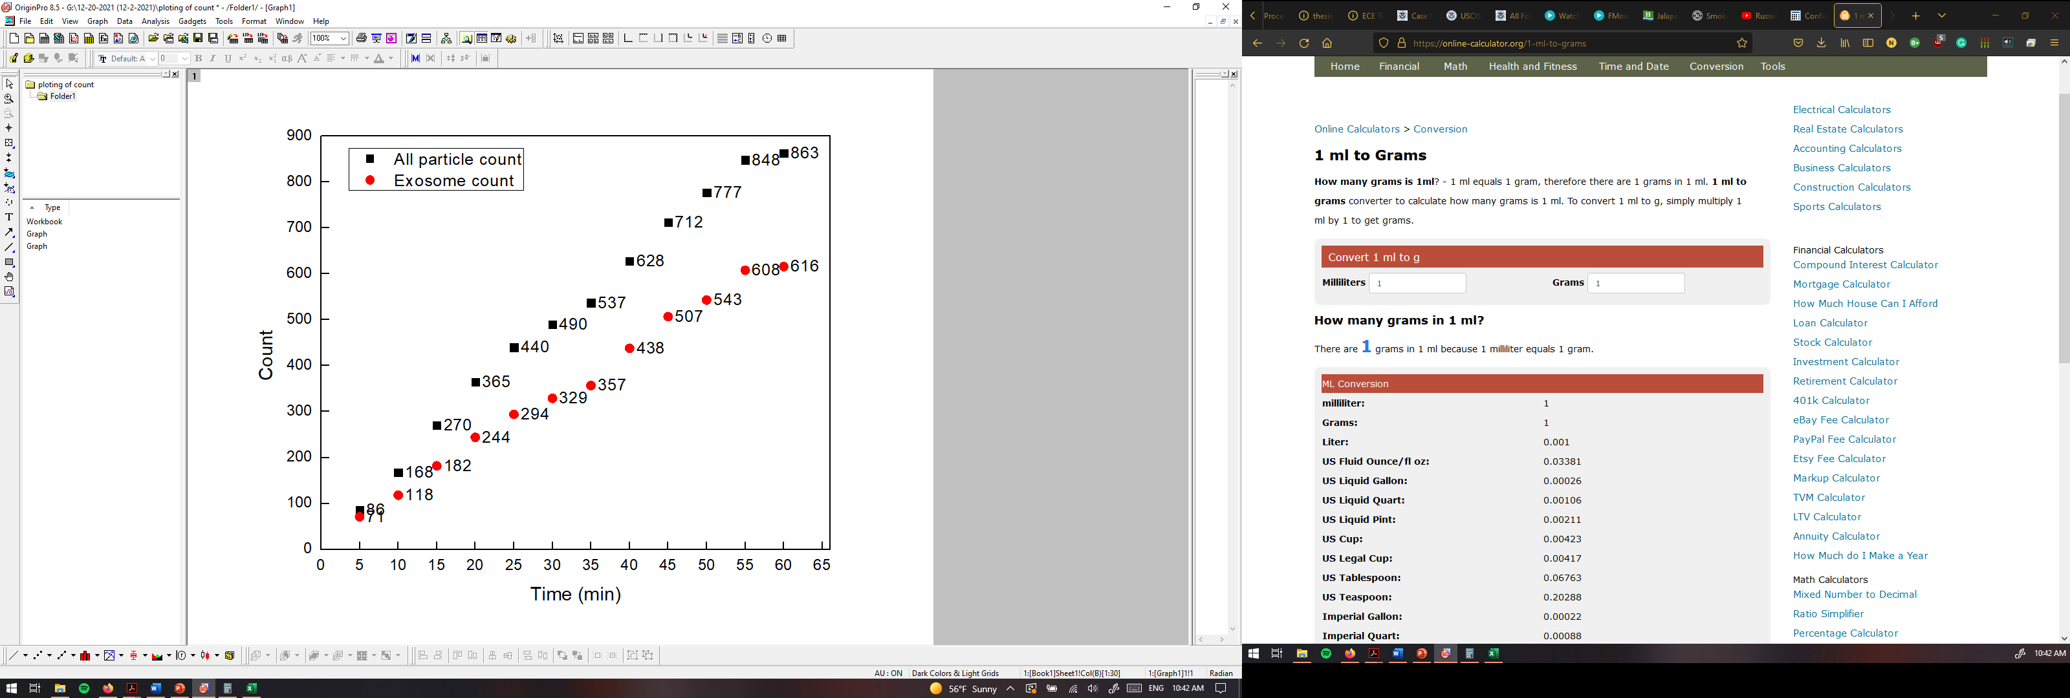
PANORAMA of Plasma Sample 0737-25A
Time: 60 min
Count: 863 (247 large)
Time: 60 min wash
Count: 166
Note: Before wash count matches the CI of stage 3 (500-1200)
After wash count matches the CI for stage 3 (155-304)
Note: 0 % response to miRNA-21
Scale bar: 10 µm

Slide 9
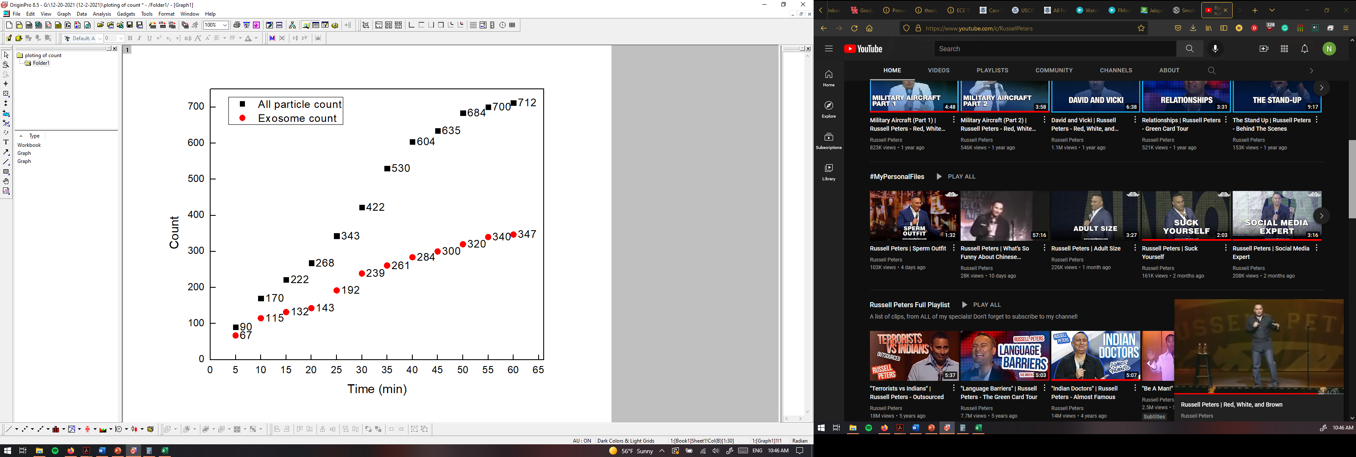
PANORAMA of Plasma Sample 0737-27A
Time: 60 min
Count: 712 (375 large)
Time: 60 min wash
Count: 184
Note: Before wash count matches the CI of stage 3 (500-1200)
After wash count matches the CI for stage 3 (155-304)
Note: 4 % response to miRNA-21
Scale bar: 10 µm

Slide 10
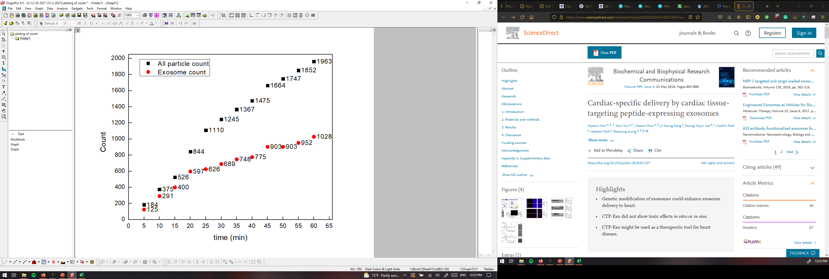
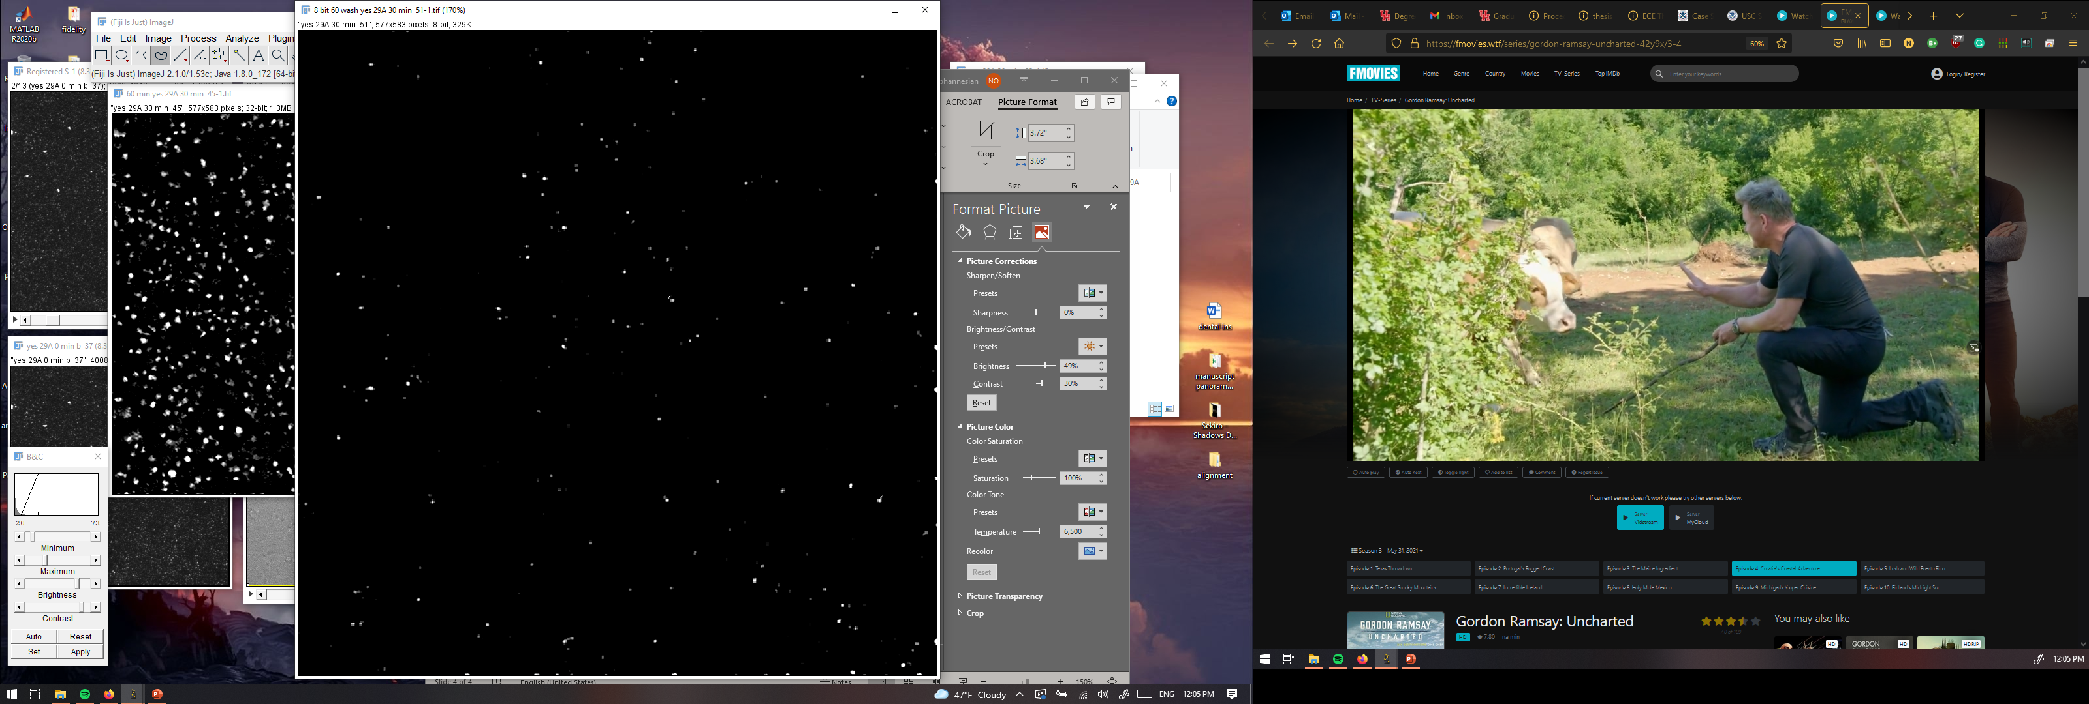
PANORAMA of Plasma Sample 0737-29A
Time: 60 min
Count: 1963 (935 large)
Time: 60 min wash
Count: 247
Note: Before wash count higher than CI of stage 3 (500-1200)
After wash count matches the CI for stage 3 (155-304)
Note: 9 % response to miRNA-21
Scale bar: 10 µm

Slide 11
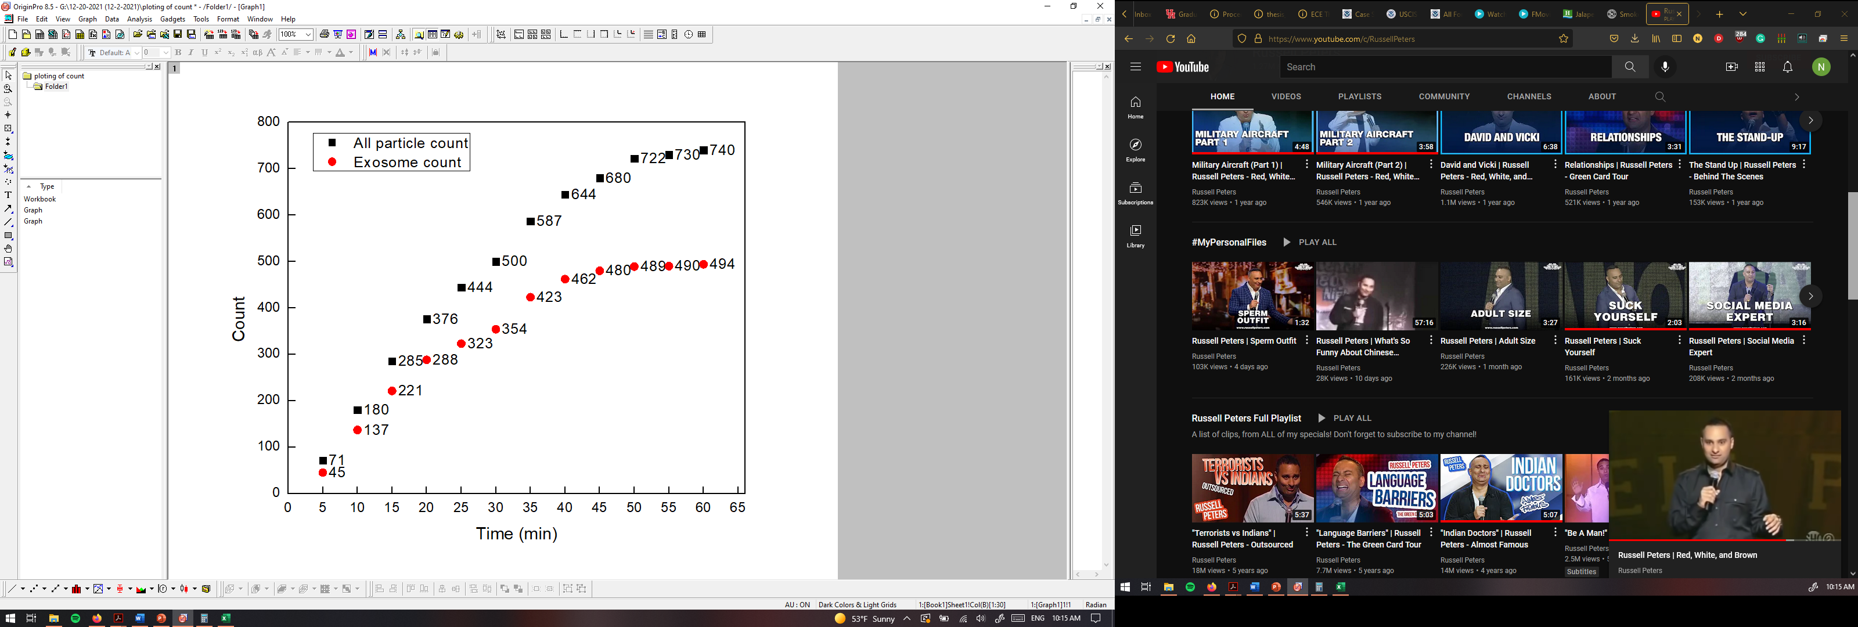
PANORAMA of Plasma Sample 0737-30A
Time: 60 min
Count: 740 (246 large)
Time: 60 min wash
Count: 129
Note: Before wash count matches CI of stage 3 (500-1200)
After wash count slightly lower than CI for stage 3 (155-304)
Note: 0 % response to miRNA-21
Scale bar: 10 µm

Slide 12
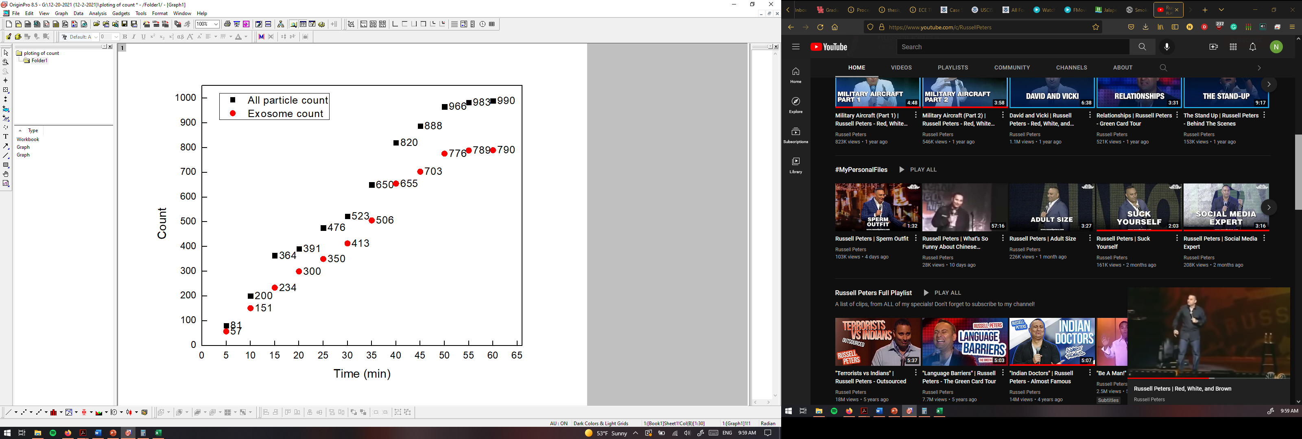

PANORAMA of Plasma Sample 0737-31A
Time: 60 min
Count: 990 (200 large)
Time: 60 min wash
Count: 303
Note: Before wash count matches CI of stage 3 (500-1200)
After wash count matches CI for stage 3 (155-304)
Note: 0 % response to miRNA-21
Scale bar: 10 µm

Slide 13


PANORAMA of Plasma Sample 0737-34A
Time: 60 min
Count: 2056 (1457 large)
Time: 60 min wash
Count: 154
Note: Before wash count exceeds CI of stage 3 (500-1200)
After wash count matches (lower end) CI for stage 3 (155-304)
Note: 0 % response to miRNA-21
Scale bar: 10 µm

Slide 14
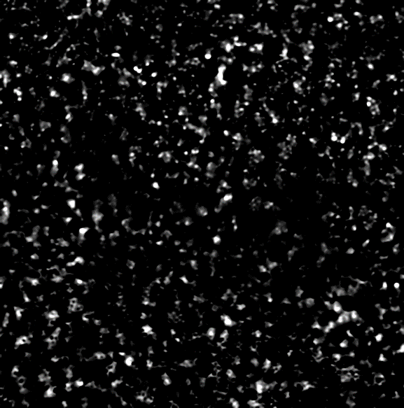

PANORAMA of Plasma Sample 0737-35A
Time: 60 min
Count: 1262 (589 large; 673 exosomes)
Time: 60 min wash
Count: 105
Note: Before wash count slightly higher than CI of stage 3 (500-1200)
After wash count slightly lower CI for stage 3 (155-304)
Note: 0 % response to miRNA-21
Scale bar: 10 µm

Slide 15
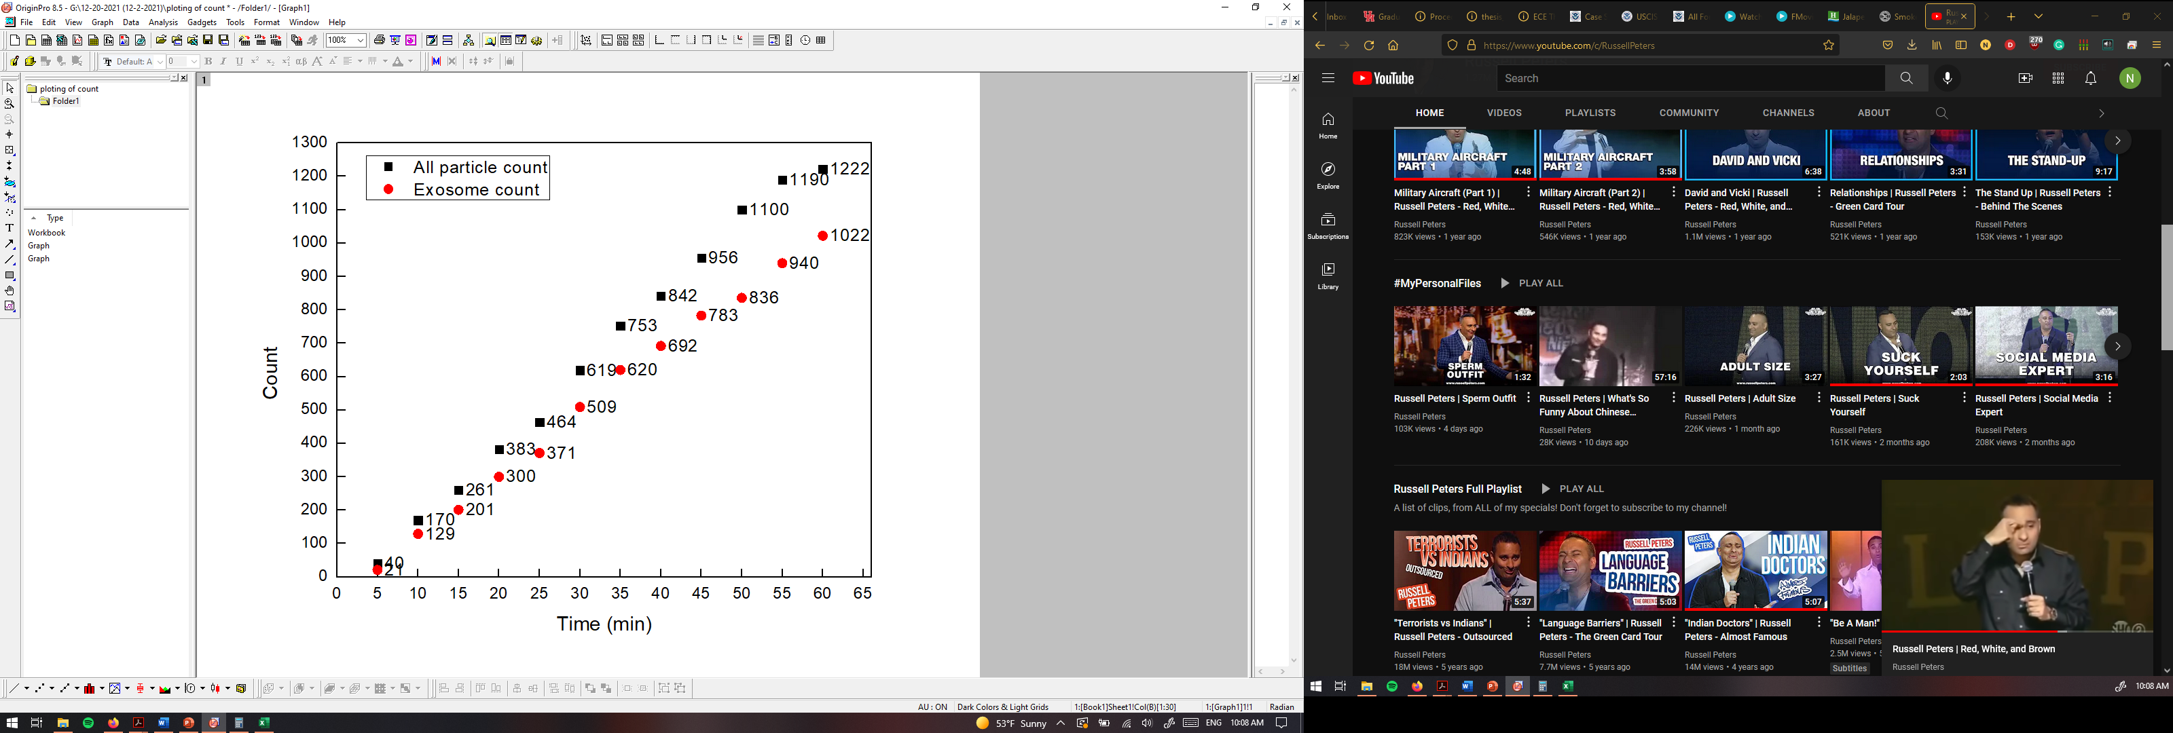

PANORAMA of Plasma Sample 0737-41A
Time: 60 min
Count: 1222 (200 large)
Time: 60 min wash
Count: 110
Note: Before wash count matches CI of stage 3 (500-1200)
After wash count lower than CI for stage 3 (155-304)
Note: 0 % response to miRNA-21
Scale bar: 10 µm

Slide 16
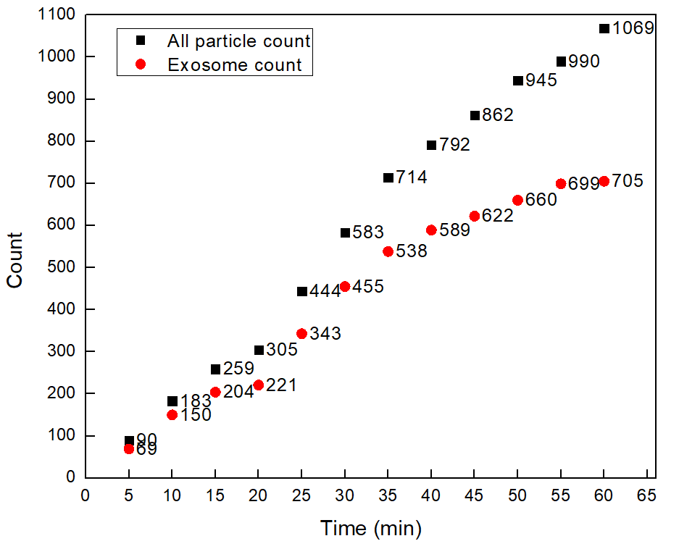


PANORAMA of Plasma Sample 0737-43A
Time: 60 min
Count: 1069 (364 large)
Time: 60 min wash
Count: 266
Note: Before wash count matches CI of stage 3 (500-1200)
After wash count matchesCI for stage 3 (155-304)
Note: 0 % response to miRNA-21
Scale bar: 10 µm

Slide 17


PANORAMA of Plasma Sample 0737-47A
Time: 60 min
Count: 2106 (913 large)
Time: 60 min wash
Count: 357
Note: Before wash count higher than CI of stage 3 (500-1200)
After wash count matches higher end CI for stage 3 (155-304)
Note: 0 % response to miRNA-21
Scale bar: 10 µm

Slide 18
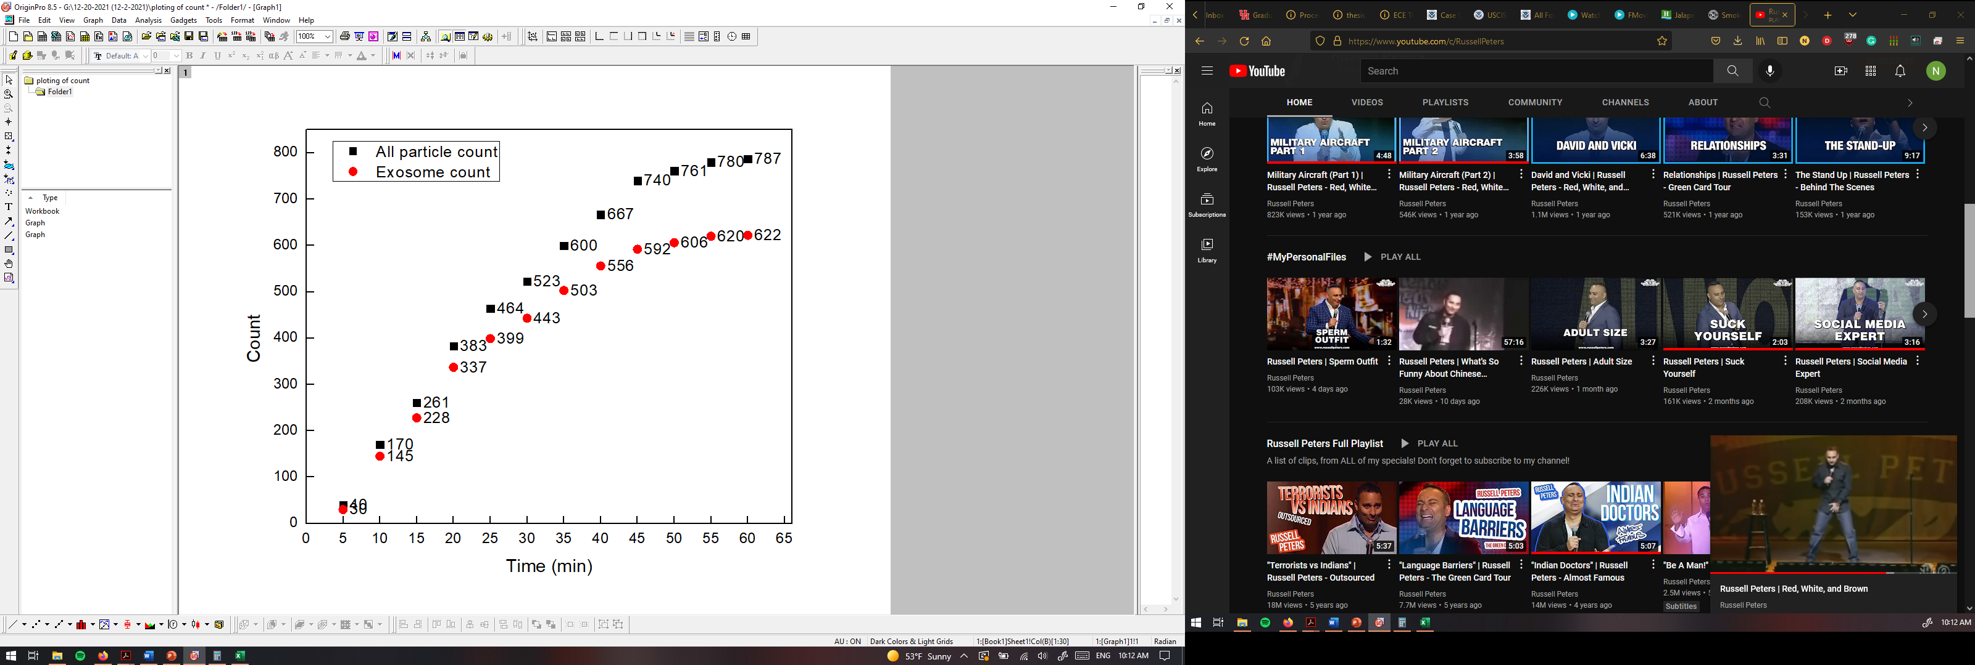

PANORAMA of Plasma Sample 0737-48A
Time: 60 min
Count: 787 (165 large)
Time: 60 min wash
Count: 153
Note: Before wash count matches CI of stage 3 (500-1200)
After wash count lower end CI for stage 3 (155-304)
Note: 0 % response to miRNA-21
Scale bar: 10 µm

Slide 19
All particles for healthy; stage 1 and 3

Slide 20
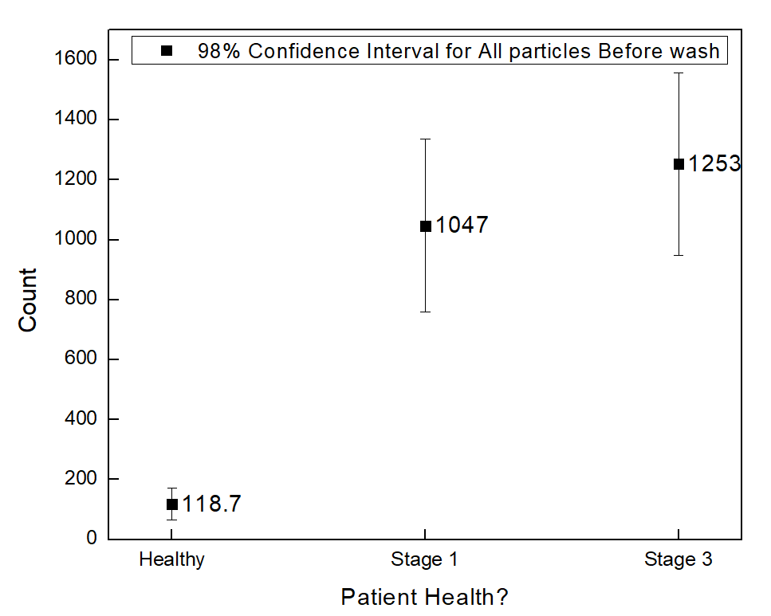
All particles for healthy; stage 1 and 3

Slide 21
Large particles for healthy; stage 1 and 3

Slide 22
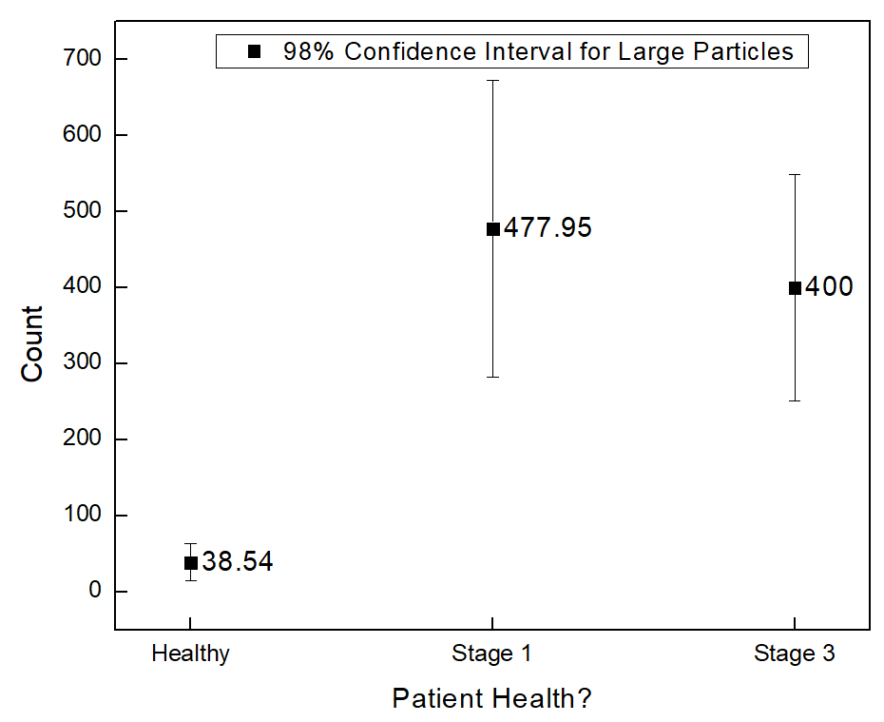
Large particles for healthy; stage 1 and 3

Slide 23
Exosomes before wash for healthy; stage 1 and 3

Slide 24
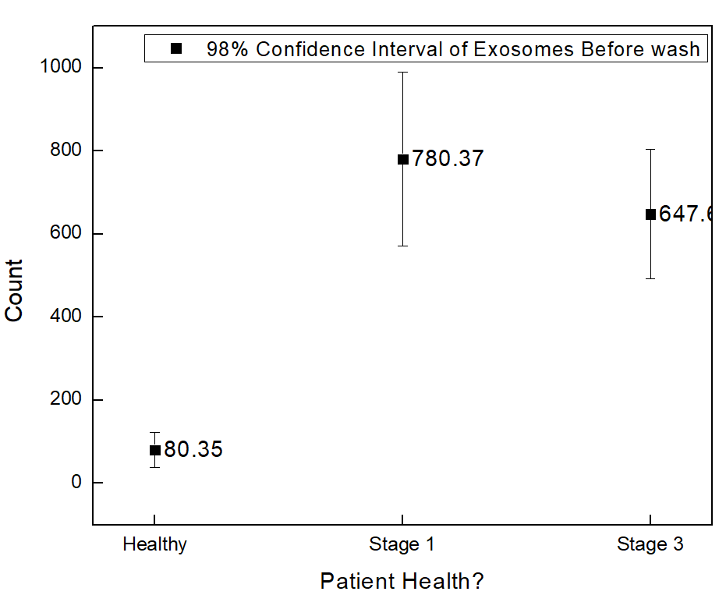
Exosomes before wash for healthy; stage 1 and 3

Slide 25
Exosomes after wash for healthy; stage 1 and 3

Slide 26
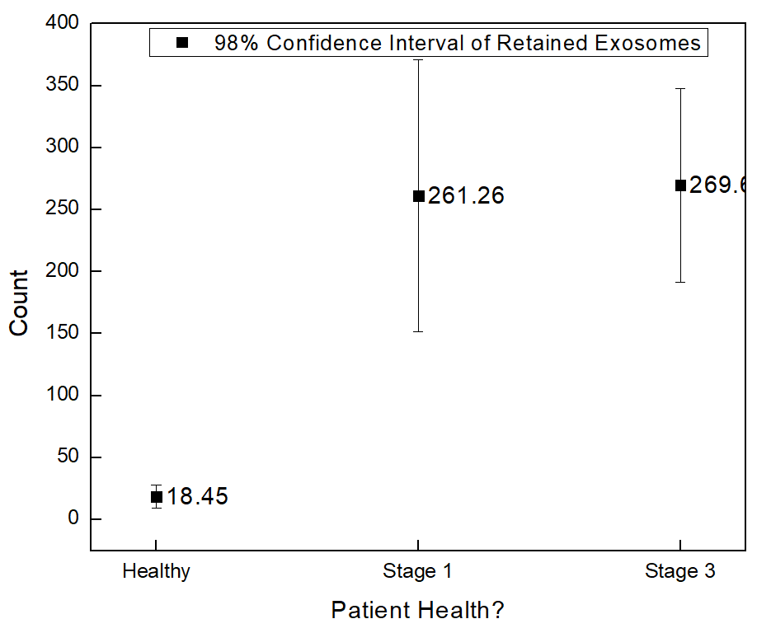
Exosomes after wash for healthy; stage 1 and 3

